Slide 1
Apache Spark
Apache Spark is a popular framework in the field of Big Data.
Spark is a distributed cluster-computing software framework.
It provides easy APIs to compute a large amount of data, while the end users barely need to know about the task and resource management across machines, which is all done by Spark under the hood.

Slide 2
Distributed Computing
To achieve distributed computing requires resource and task management over a cluster of machines.

Slide 3
Why spark?
Hadoop is extensively used as Hadoop framework is based on a simple programming model (MapReduce) and it enables a computing solution that is scalable, flexible, fault-tolerant and cost effective.
But the main concern is to maintain speed in processing large datasets in terms of waiting time between queries and waiting time to run the program.
Spark was introduced by Apache Software Foundation for speeding up the Hadoop computational process.
Spark uses Hadoop in two ways – one is storage and second is processing. Since Spark has its own cluster management computation, it uses Hadoop for storage purpose only.

Slide 4
Apache Spark
Apache Spark is a lightning-fast cluster computing technology, designed for fast computation.
It is based on Hadoop MapReduce and it extends the MapReduce model to efficiently use it for more types of computations, which includes stream processing.
The main feature of Spark is its in-memory cluster computing that increases the processing speed of an application.
Spark is designed to cover a wide range of workloads such as batch applications, iterative algorithms, and streaming.

Slide 5
Features of Apache Spark
Speed -very fast
Supports multiple languages -spark provides built-in APIs in Java, Scala, or Python.
Advanced Analytics − Spark not only supports ‘Map’ and ‘reduce’. It also supports SQL queries, Streaming data, Machine learning (ML), and Graph algorithms.

Slide 6
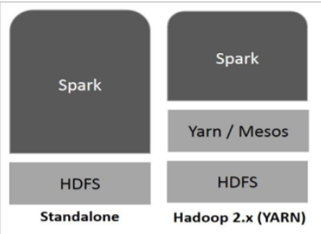
Spark Built on Hadoop
Standalone − Spark Standalone deployment means Spark occupies the place on top of HDFS(Hadoop Distributed File System) and space is allocated for HDFS, explicitly. Here, Spark and MapReduce will run side by side to cover all spark jobs on cluster.
Hadoop Yarn − Hadoop Yarn deployment means, simply, spark runs on Yarn. It helps to integrate Spark into Hadoop ecosystem or Hadoop stack. It allows other components to run on top of stack.

Slide 7
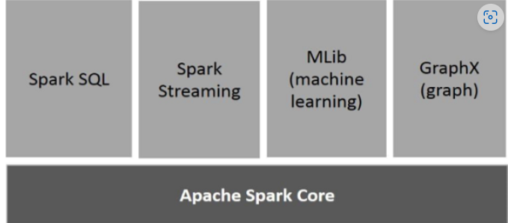
Components of Spark

Slide 8
Components of Spark
Apache Spark Core
Spark Core is the underlying general execution engine for spark platform that all other functionality is built upon.
It provides In-Memory computing and referencing datasets in external storage systems.
Spare Core is the basic building block of Spark, which includes all components for job scheduling, performing various memory operations etc.

Slide 9
Components of Spark
Spark SQL
Spark SQL is a component on top of Spark Core which provides support for structured and semi-structured data.
Spark Streaming
Spark Streaming leverages Spark Core's fast scheduling capability to perform streaming analytics. It ingests data in mini-batches and performs RDD (Resilient Distributed Datasets) transformations on those mini-batches of data.
MLlib (Machine Learning Library)
MLlib is a distributed machine learning framework above Spark because of the distributed memory-based Spark architecture.
GraphX
GraphX is a distributed graph-processing framework on top of Spark. It provides an API for expressing graph computation that can model the user-defined graphs by using Pregel abstraction API. It also provides an optimized runtime for this abstraction.

Slide 10
Apache Spark Architecture
Apache Spark has a master-slave architecture with its cluster made up of a single master and multiple slaves.
This architecture relies on two abstractions:
Resilient Distributed Dataset (RDD)
Directed Acyclic Graph (DAG)

Slide 11
A Spark application consists of a driver program and executes parallel computing on a cluster.
To start a Spark application, the driver program that runs on a host machine will first initiate a SparkContext object.
This SparkContext object will communicate with a cluster manager, which can be either Spark’s own standalone cluster manager, or YARN, or Kubernetes, to acquire resources for this application.
Then, the SparkContext object will send the application code and tasks to the worker nodes.

Slide 12
For one application, a worker node can have multiple executors
During the computation for an application, each executor keeps data in memory or disk storage and runs tasks.
In this way, executors are isolated from each other, and the tasks for the same application run in parallel.

Slide 13

https://spark.apache.org/docs/latest/cluster-overview.html

Slide 14
https://spark.apache.org/examples.html
https://phoenixnap.com/kb/install-spark-on-ubuntu
https://www.nbshare.io/notebook/187478734/How-To-Read-CSV-File-Using-Python-PySpark/
https://spark.apache.org/docs/latest/sql-data-sources-csv.html

Slide 15
Resilient Distributed Dataset (RDD)
Resilient Distributed Datasets (RDD) is a fundamental data structure of Spark.
It is an immutable distributed collection of objects.
dataset in RDD is divided into logical partitions, which may be computed on different nodes of the cluster
Formally, an RDD is a read-only, partitioned collection of records. that can be operated in parallel.
An original RDD cannot be changed , but a new RDDs can be created by performing coarse-grain operations, like transformations, on an existing RDD.

Slide 16
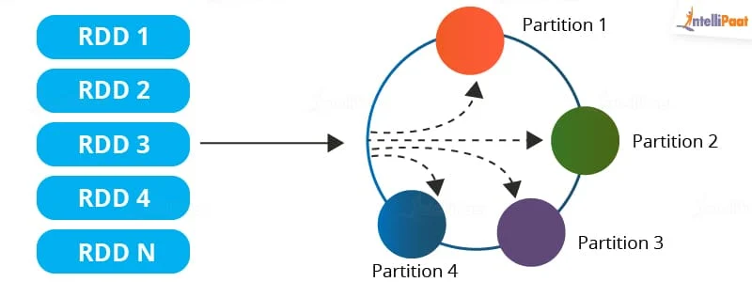

Slide 17
Features of an RDD in Spark
Resilience: RDDs track data lineage information to recover lost data, automatically on failure. It is also called fault tolerance.
Distributed: Data present in an RDD resides on multiple nodes. It is distributed across different nodes of a cluster.
Lazy evaluation: Lazy Evaluation in Sparks means Spark will not start the execution of the process until an Action is called. Once an Action is called, Spark starts looking at all the transformations and creates a DAG.
DAG is sequence of operations that need to be performed in a process to get the resultant output.

Slide 18
Immutability: Data stored in an RDD is in the read-only mode
In-memory computation: An RDD stores any immediate data that is generated in the memory (RAM) than on the disk so that it provides faster access.
Partitioning: Partitions can be done on any existing RDD to create logical parts.

Slide 19
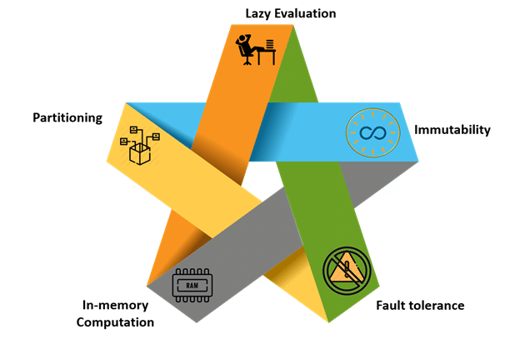

Slide 20
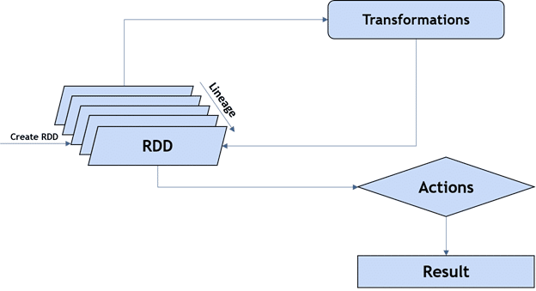
Operations on RDDs
There are two basic operations that can be done on RDDs. They are transformations and actions.

Slide 21
Advantages of RDD
RDD aids in increasing the execution speed of Spark.
RDDs are the basic unit of parallelism and hence help in achieving the consistency of data.
RDDs help in performing and saving the actions separately
They are persistent as they can be used repeatedly.
Limitation of RDD
There is no input optimization available in RDDs
One of the biggest limitations of RDDs is that the execution process does not start instantly.
No changes can be made in RDD once it is created.

Slide 22
Variables
In Scala, we declare variables with val or var.
The syntax convention for Scala is camelCase.
val counterVal = 0
counterVal: Int = 0
Any variable that is declared using val is immutable, therefore we cannot alter its value.
Arrays are basically how Scala handles lists

Slide 23
var myArr = ArrayBuffer(2, 3 , 4, 5, 6)
myArr: scala.collection.mutable.ArrayBuffer[Int] = ArrayBuffer(2, 3, 4, 5, 6)
myArr(3)
To add an element to an array use += to append a value:
myArr += 10
Looping with array elements :
for (n <- myArr) { println(n) }

Slide 24
Mapping will iterate through each item in list and transform it into a different element.
myArr.map(n => n * 5)
Filtering will return a subset of the original data or array if it meets the criteria or conditions state.
myArr.filter(n => n % 2 == 0)

